Slide 1
Project Crash Course
Prof. Dr. Dirk Riehle
Friedrich-Alexander University Erlangen-Nürnberg
AMOS B01
Licensed under CC BY 4.0 International
Notes:
It is Friedrich-Alexander University Erlangen-Nürnberg – FAU, in short.
Corporate identity wants us to say “Friedrich-Alexander University”.

Slide 2
Project Goal
To deliver useful software at the end of the project that can be developed further.

Slide 3
Software Development Process
Scrum Process Practices
XP Technical Practices

Slide 4
Scrum Roles
Product
Owner
PO
Software
Developer
SD
SM
Scrum
Master

Slide 5
Core (“Committed”) Role Responsibilities
Definition of product owner
  Holds overall responsibility for the product being developed
  Provides product vision and product requirements
  Plans and helps plan development and tracks progress
Definition of software developer
  Holds overall responsibility for design and implementation of product
  Estimate complexity (“size”) of product features to be implemented
  Organizes and allocates design and implementation tasks
Definition of Scrum master
  Is responsible for tracking and resolving impediments

Slide 6
Industry Partner Responsibilities
Definition of industry partner
  Provides high-level requirements
  Provides feedback in defined intervals
  Cf. Industry Guidance document

Slide 7
Overall Project Time-Line
Mid-Project Release
Final Release
Sprints 1 to n/2
Sprints (n/2+1) to n
time
Sprint 1
Sprint n
...
P
E
3R
P
E
3R
P: Planning
E: Execution
3R: Review, release, and retrospective
E.g. week 1
...
E.g. week n
time

Slide 8
Time-boxed Sequence of Releases
Definition of release
  A named, identifiable, consistent, and useful snapshot of the software and related relevant artifacts
Definition of sprint release
  A release used to gather feedback from industry partner to help steer the project (every week)
Definition of project release
  A release used to deploy for production (twice during the semester: mid-term and at end of semester)

Slide 9
The Scrum Sprint (Conceptualization)
Wed
Thu
Mon
Tue
09:00
Sprint
planning
Daily Scrum
Daily Scrum
Daily Scrum
...
Product management
Software development
Process improvement
Product management
Software development
Process improvement
Product management
Software development
Process improvement
Product management
Software development
Process improvement
Review
13:00
Next sprint
preparation
Release
Retrospective
17:00

Slide 10
Project Schedule
See Course index → Course schedule
  For date ↔ course week mapping
See Course deliverables slide deck
  For deliverables due for a course week
Notes:
The main deliverables:
Initial and mid-term release plan
Mid-term and final release

Slide 11
Other Role Responsibilities
Definition of review and release manager
  Prepares the product for review session
  Releases the product after agreement

Slide 12
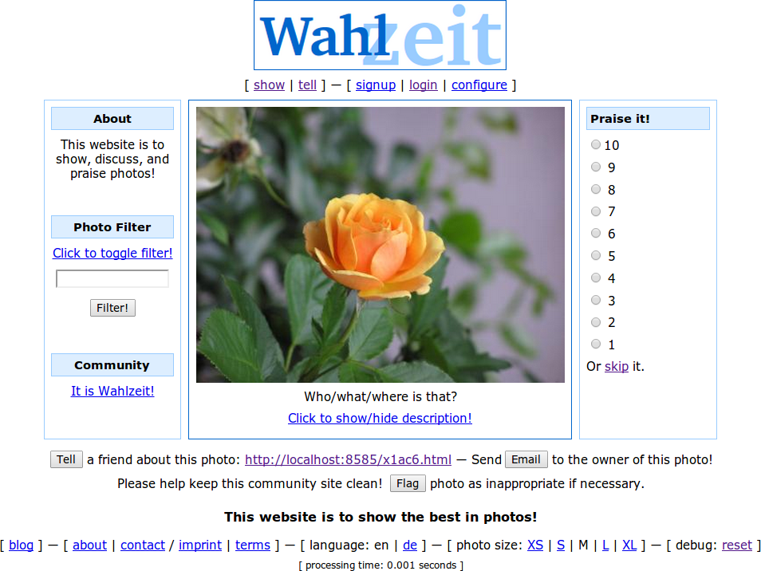

Slide 13
Product Vision [1] and Project Mission
Product vision
  The Flowers social network helps flower enthusiasts worldwide to connect with each other and enjoy following their favorite hobby online. Centered on showing and rating favorite flower photos, it inspires growing and presenting ever more beautiful flowers. With a highly engaged user community, Flowers is the best place for producers and sellers of gardening supply to reach out to customers and engage with them. Such engagement involves understanding flower enthusiasts’ needs around gardening supplies and selling to them.
Project mission
  The mission of the AMOS project is to enhance the Wahlzeit software with a mobile cross-plattform app, available both on Android and iPhone. To achieve this, the current domain model interface needs to be refactored into a REST-based API to be used by all user interfaces, whatever the modality.
[1] See http://goo.gl/pOazTZ

Slide 14
Feature and User Story
Definition of feature
  A distinguishing characteristic of a software item (for example, performance, portability, functionality)
  (IEEE 829)
Definition of user story
  A description mechanism for a software feature used to create a shared understanding of the feature; follows an established pattern
  The description pattern is: As a “user role”, I need “a function”, so that “I get business value” where the parts in quotation marks are substituted
Example user stories
  Rate-a-photo: As a visitor, I can rate a photo with a numerical value 1-10, so that I can share my opinion about the photo.
  Tell-a-friend: As a user, I need a function to tell a friend about a flower photo, so that I can share my passion for flowers.

Slide 15
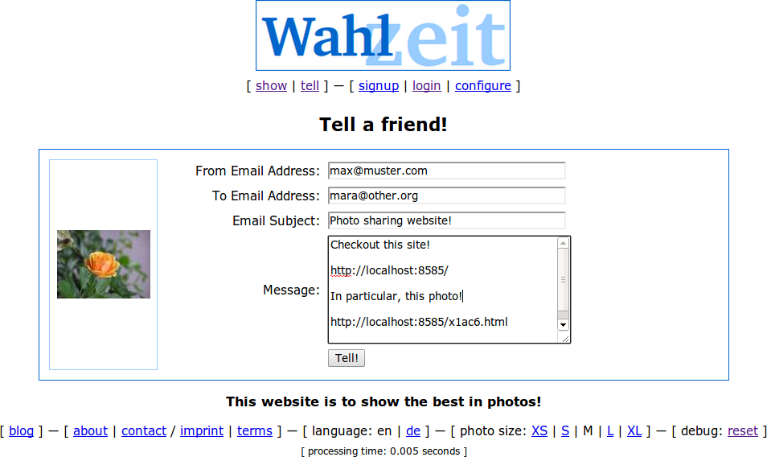
The Tell-a-Friend Feature

Slide 16
Quality Criteria for Feature Descriptions
I | ndependent: Features should be independent of each other.
N | egotiable: A feature is man-made, not cast in stone.
V | aluable: Every feature should have business value.
E | stimatable: A feature should be precise so that size can be estimated.
S | mall: A feature should be small enough for one iteration.
T | estable: A feature should have testable success criteria.

Slide 17
Flowers Planning Documents
See http://goo.gl/FRfym

Slide 18
Product Backlog and Product Backlog Entry
Definition of product backlog
  An incomplete and evolving list of features prioritized by business value and used in product planning
Definition of product backlog entry
  A named, identifiable, and prioritized feature or bug that is part of a product backlog

Slide 19
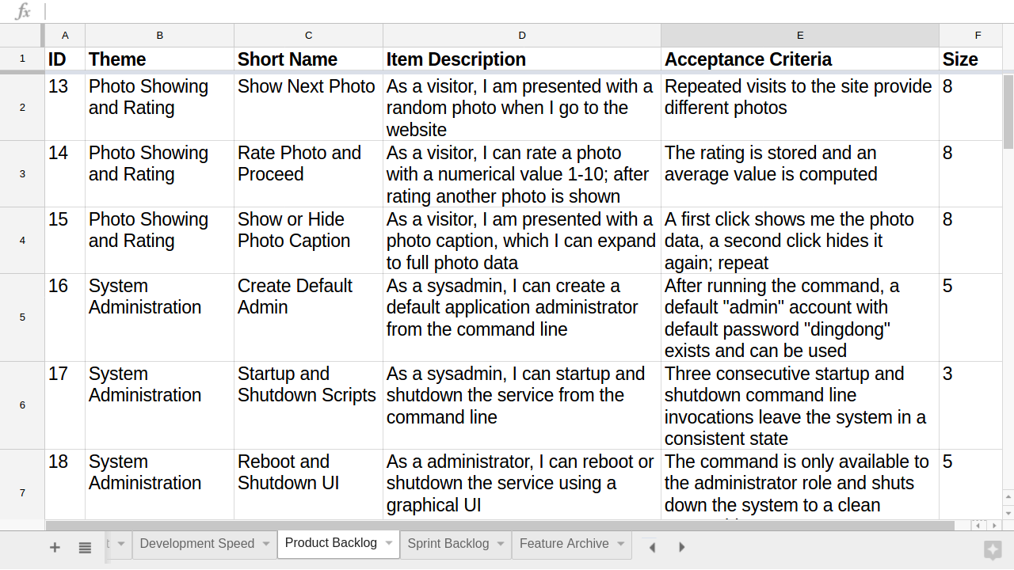
Flowers Product Backlog

Slide 20
Sprint Backlog and Sprint Backlog Entry
Definition of sprint backlog
  A list of sprint backlog entries that the software developers have committed to implementing in the current sprint
Definition of sprint backlog entry
  A high-quality product backlog entry that has been estimated for size and committed-to to being implemented by the software developers

Slide 21
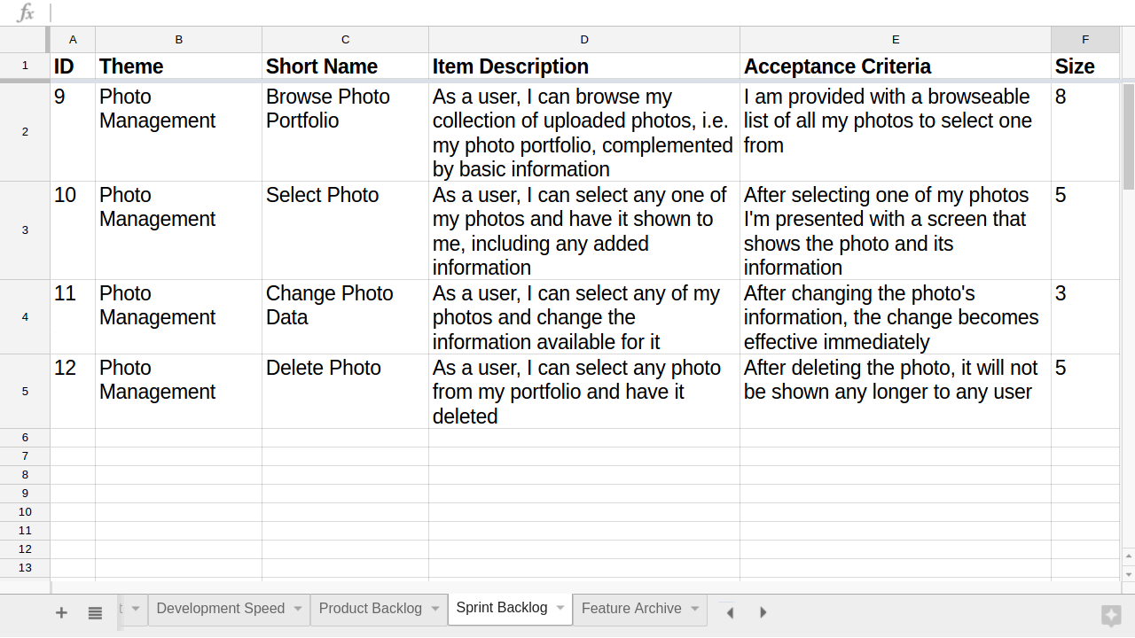
Flowers Sprint Backlog

Slide 22
The AMOS Team Meeting
Team Meeting Day
Previous
Sprint
...
1. Meeting Preparation
2. Sprint Review
3. Sprint Release
Team
Meeting
4. Sprint Retrospective
5. Sprint Planning
Next
Sprint
6. Meeting After-work
...

Slide 23
1. Meeting Preparation
This sprint’s review and release manager
  Ensure that a working demo system will be available
  Tag release candidate with sprint-xx-release-candidate
    where xx is your sprint number (see project schedule)
Next sprint’s product owner
  Ensure that product backlog is ready for sprint planning
    Include new user stories
    May transcribe bugs from issues
    May include refactorings

Slide 24
2a. Sprint Review
This sprint’s review and release manager
  Check-out fresh code base using release candidate tag
  Compile, build, and run tests for release candidate
  Deploy release candidate to test environment

Slide 25
2b. Sprint Review
This sprint’s product owner
  Walk through sprint backlog feature by feature
    Ask developer to demo current feature
    Check fulfillment of acceptance criteria
    Check other criteria incl. logging output for problems
    If successfully implemented, move feature to feature archive
    If not successfully implemented, move feature back to product backlog
Software developer
  Demo feature as requested by product manager
  Answer questions about feature design and implementation

Slide 26
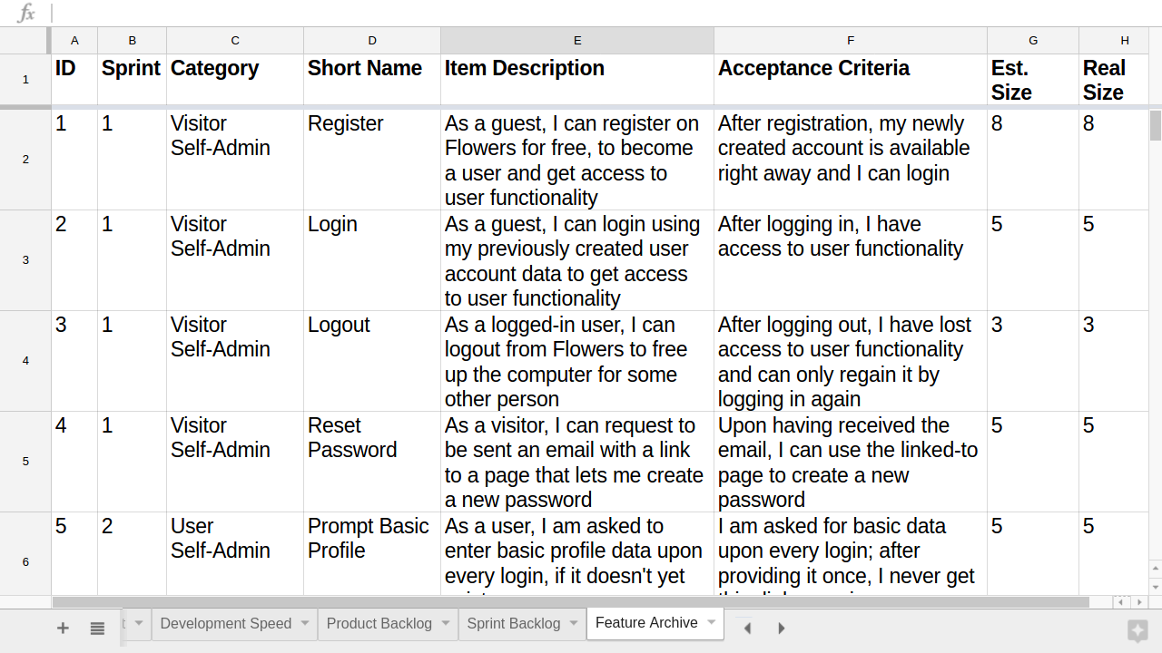
Flowers Feature Archive

Slide 27
3. Sprint Release
This sprint’s product owner
  Decide whether release candidate should be released
    Only in case of significant regression should you not release
  Consult with software developers if necessary
This sprint’s review and release manager
  If the release candidate is to be released
    Deploy sprint release to operations environment
    Tag release with sprint-xx-release
      where xx is your sprint number
  If you maintain a work log (optional)
    Update work log with release information

Slide 28
4. Sprint Retrospective
This sprint’s Scrum master
  Review this sprint’s impediments
    Report on progress
    Review remaining problems
Next sprint’s Scrum master
  Make roll call as to new impediments
    Take note of people's impediments
    Allow everyone to make a suggestion
  Note impediments in impediments backlog
Everyone
  Answer to happiness index

Slide 29
5. Sprint Planning
This (now new) sprint’s product owner
  Reprioritize backlog items, if necessary, on-the-fly
  Work through top-prioritized backlog items one-by-one until finished
    For each product backlog item, explain it, ask developers to estimate and commit
    You are finished, if the team does not want to take on more backlog items
Software developer
  Estimate size of each backlog item using planning poker
  After planning, commit to backlog items put into sprint backlog
Everyone
  Make sure roles for sprint are clear to everyone

Slide 30
Story Points
Story point
  An arbitrary numeric measure of size of a given feature
Properties
  Is a measure of size, not of effort or duration
  Measured in non-linear increments, forcing choice
  Is socially agreed upon, depends on team estimation history
  Is independent of a particular person (and their skills)
  Is mapped to time using the team's velocity (dev. speed)
Points | Meaning
0 | No effort
1 | Minimal effort
2 | Small effort
3 | Medium effort
5 | Large effort
8 | Very large effort
13 | Too large effort

Slide 31
Flow Diagram for Sprint Planning [1]
start
Product Owner
Picks Story
Each Developer
Deliberates
Developers Re-
view Total Effort
Product Owner
Reads Story
Each Developer
Plays Card
no
Done?
yes
Product Owner
Explains Story
yes
end
Agreement?
Product Owner
Adjusts Backlog
no
[1] A simple planning poker cards replacement can be found in the planning documents
Developers
Discuss Story

Slide 32
6. Meeting After-work
This sprint’s product owner
  Update planning documents to consistent state
    Clean up product and sprint backlog
    Ensure feature archive is current
    Update release plan with actual effort for sprint
This sprint’s Scrum master
  Work on resolving impediments during sprint
  Document resolutions in impediments backlog

Slide 33
Weekly Checklist for Artifacts
Planning documents
  Clean release plan, product backlog, sprint backlog, and feature archive
Software product
  Tagged, testable, deployable software code base and product
Process improvement
  Impediments documented, discussed; happiness index survey taken

Slide 34
Next Steps
See Course deliverables slide deck

Slide 35
Thank you! Questions?
dirk.riehle@fau.de – http://osr.cs.fau.de
dirk@riehle.org – http://dirkriehle.com – @dirkriehle
DR

Slide 36
Credits and License
Original version
  © 2012-2019 Dirk Riehle, some rights reserved
  Licensed under Creative Commons Attribution 4.0 International License
Contributions
  ...

